Slide 1


5G Network
Presented By Supervised by
Department of Information and communication Technology(ICT)
Mawlana Bhashani Science and Technology university ,Santosh, Tangail
Afrin Zaman
IT-18008
&
Mahfuza Talukdar
IT-18009
Nazrul Islam
Assistant Professor
Dept of ICT
MBSTU
1

Slide 2
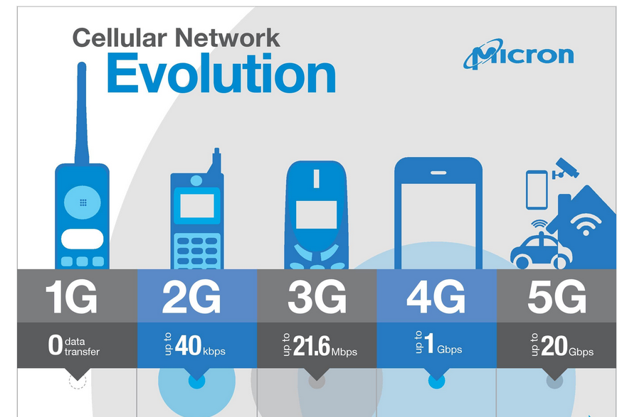
5G - Introduction
Radio technologies have evidenced a rapid and multidirectional evolution with the launch of the analogue cellular systems in 1980s.
Thereafter, digital wireless communication systems are consistently on a mission to fulfil the growing need of human beings (1G, …4G, or now 5G).
2

Slide 3
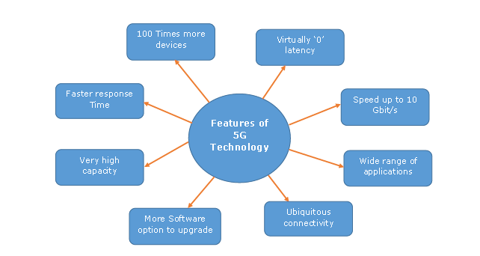
Salient Features of 5G
5th Generation Mobile Network or simply 5G is the forthcoming revolution of mobile technology
The features and its usability are much beyond the expectation of a normal human being.
With its ultra-high speed, it is potential enough to change the meaning of a cell phone usability.
3

Slide 4
What is 5G Technology?
The 5G technology is expected to provide a new (much wider than the previous one) frequency bands along with the wider spectral bandwidth per frequency channel. As of now, the predecessors (generations) mobile technologies have evidenced substantial increase in peak bit rate. Then — how is 5G different from the previous one (especially 4G)? The answer is — it is not only the increase in bitrate made 5G distinct from the 4G, but rather 5G is also advanced in terms of −
High increased peak bit rate
Larger data volume per unit area (i.e. high system spectral efficiency)
High capacity to allow more devices connectivity concurrently and instantaneously
Lower battery consumption
Better connectivity irrespective of the geographic region, in which we are
Larger number of supporting devices
Lower cost of infrastructural development
Higher reliability of the communications
4

Slide 5
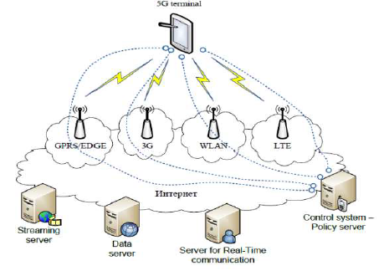
Architecture of 5G
As shown in the following image, the system model of 5G is entirely IP based model designed for the wireless and mobile networks.
5

Slide 6
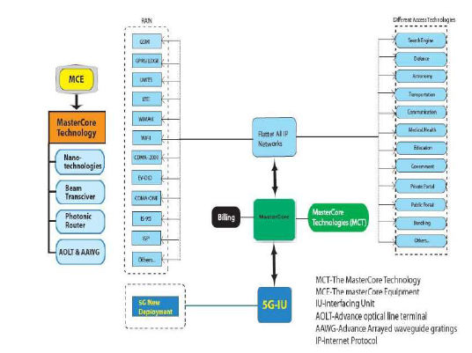
The Master Core Technology
As shown in the Figure, the 5G Master Core is convergence point for the other technologies, which have their own impact on existing wireless network.
Interestingly, its design facilitates Master Core to get operated into parallel multimode including all IP network mode and 5G network mode.
In this mode (as shown in the image given below), it controls all network technologies of RAN and Different Access Networks (DAT). Since, the technology is compatible and manages all the new deployments (based on 5G), it is more efficient, less complicated, and more powerful.
6

Slide 7
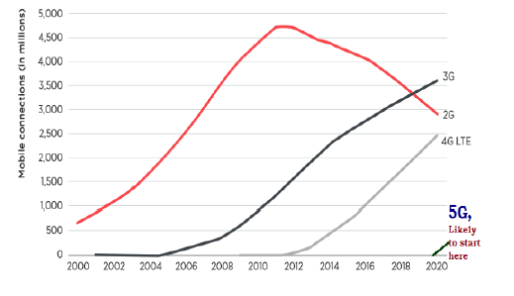
5G - Time Period Required
Normally, it is expected that the time period required for the 5G technology development and its implementation is about five years more from now (by 2020).
But to becoming usable for the common people in developing countries, it could be even more.
7

Slide 8
5G - Applications
Some of the significant applications are −
It will make unified global standard for all.
Network availability will be everywhere and will facilitate people to use their computer and such kind of mobile devices anywhere anytime.
Because of the IPv6 technology, visiting care of mobile IP address will be assigned as per the connected network and geographical position.
Its application will make world real Wi Fi zone.
Its cognitive radio technology will facilitate different version of radio technologies to share the same spectrum efficiently.
Its application will facilitate people to avail radio signal at higher altitude as well.
8

Slide 9

5G - Advancement
Application of 5G is very much equivalent to accomplishment of dream. It is integrated with beyond the limit advance features in comparison to the previous technologies.
In comparison to previous radio technologies, 5G has following advancement −
Practically possible to avail the super speed i.e. 1 to 10 Gbps.
Latency will be 1 millisecond (end-to-end round trip).
1,000x bandwidth per unit area.
Feasibility to connect 10 to 100 number of devices.
Worldwide coverage.
About 90% reduction in network energy usage.
Battery life will be much longer.
Whole world will be in wi fi zone.
9

Slide 10
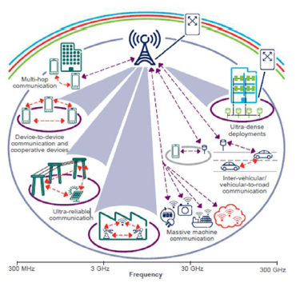
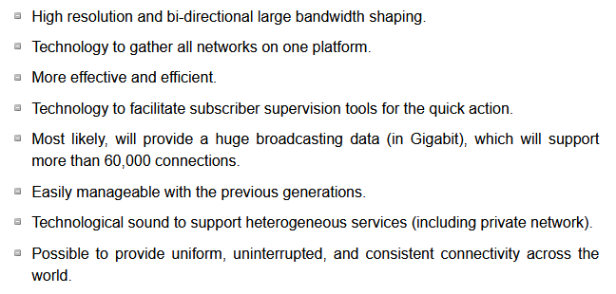
5G - Advantages
5th generation technology offers a wide range of features, which are beneficial for all group of people including, students, professionals (doctors, engineers, teachers, governing bodies, administrative bodies, etc.) and even for a common man.
10

Slide 11
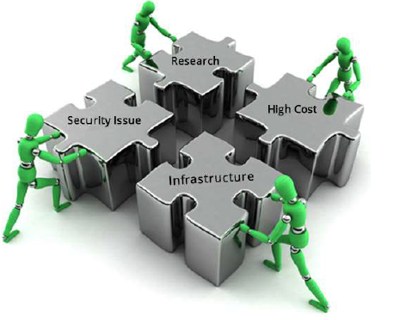
Disadvantages of 5G Technology
Though, 5G technology is researched and conceptualized to solve all radio signal problems and hardship of mobile world, but because of some security reason and lack of technological advancement in most of the geographic regions, it has following shortcomings −
Technology is still under process and research on its viability is going on.
The speed, this technology is claiming seems difficult to achieve (in future, it might be) because of the incompetent technological support in most parts of the world
Many of the old devices would not be competent to 5G, hence, all of them need to be replaced with new one — expensive deal.
Developing infrastructure needs high cost.
Security and privacy issue yet to be solved.
11

Slide 12
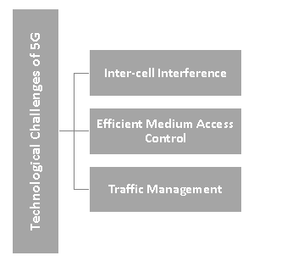
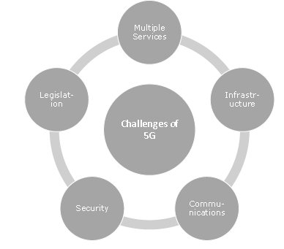
5G - Challenges
The challenges of 5G are categorized into the following two headings −
Technological Challenges Common Challenges
12

Slide 13
.
Thank u
All
13

